Slide 1
Dhaka Traffic Detection
Course Code: CSE499
Course Title: Capstone Project

Slide 2
Name of our Group Members
1. Fabliha Bushra
ID: 163014029
2. Mohammad Navid Nayyem
ID: 172014003
3. KH. Nafiu Nur Rashid
ID: 172014026

Slide 3
Outlines
Introduction
Aim and Objective
Understanding Dhaka Traffic
Classes of Vehicle
Dataset Statistics
Some Output Pictures After Model Train
Image Annotation using labelImg tool
Context Level Data-Flow Diagram
Methodology
Final Outcome
Gantt Chart

Slide 4
Introduction
Dhaka is the most densely populated city in the world.
Automated vehicles detection.
Helpful for maintaining a better parking management system.
Machine learning methods.
Set of vehicle images.
Detect different types of vehicles from the images.
Training our model by using YOLOv5 in Kaggle Notebook.

Slide 5
Aim and Objective
Vehicle Images Annotation.
Create dataset using annotated image with xml file.
Train a model using dataset.
Create an Application Programming Interface (API).
Develop a fully functioning Android app to detect the vehicle classes perfectly from video or images.
Easy to use.
The wastage of time will reduce as the traffic jam will be controlled.
Provide good service to the users.
Reduce the difficulty to manage traffic.
Beneficial for better parking management system.

Slide 6
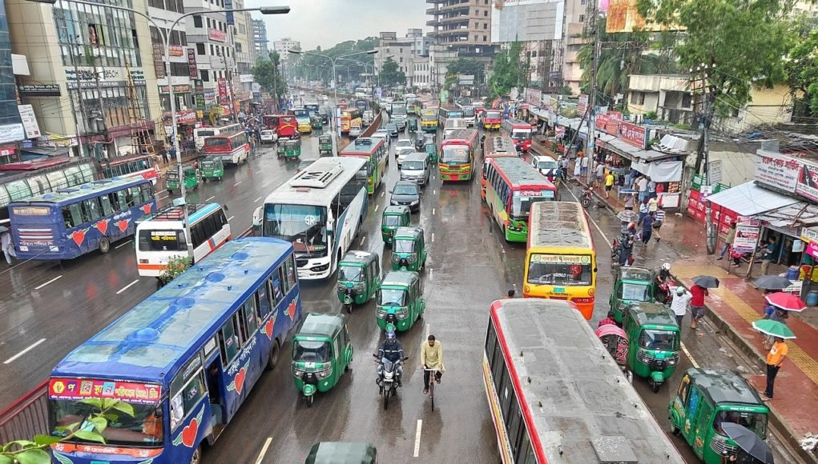
Understanding Dhaka traffic
Dhaka’s traffic is traffic in extremis.
70,000 rickshaws, 118254 private cars and 5407 buses were licensed in 2020.
Only 7.5% of Dhaka is made up of roads.
Average speed of vehicles are 6.4kmph
Small amount of traffic light system to control traffic.

Slide 7
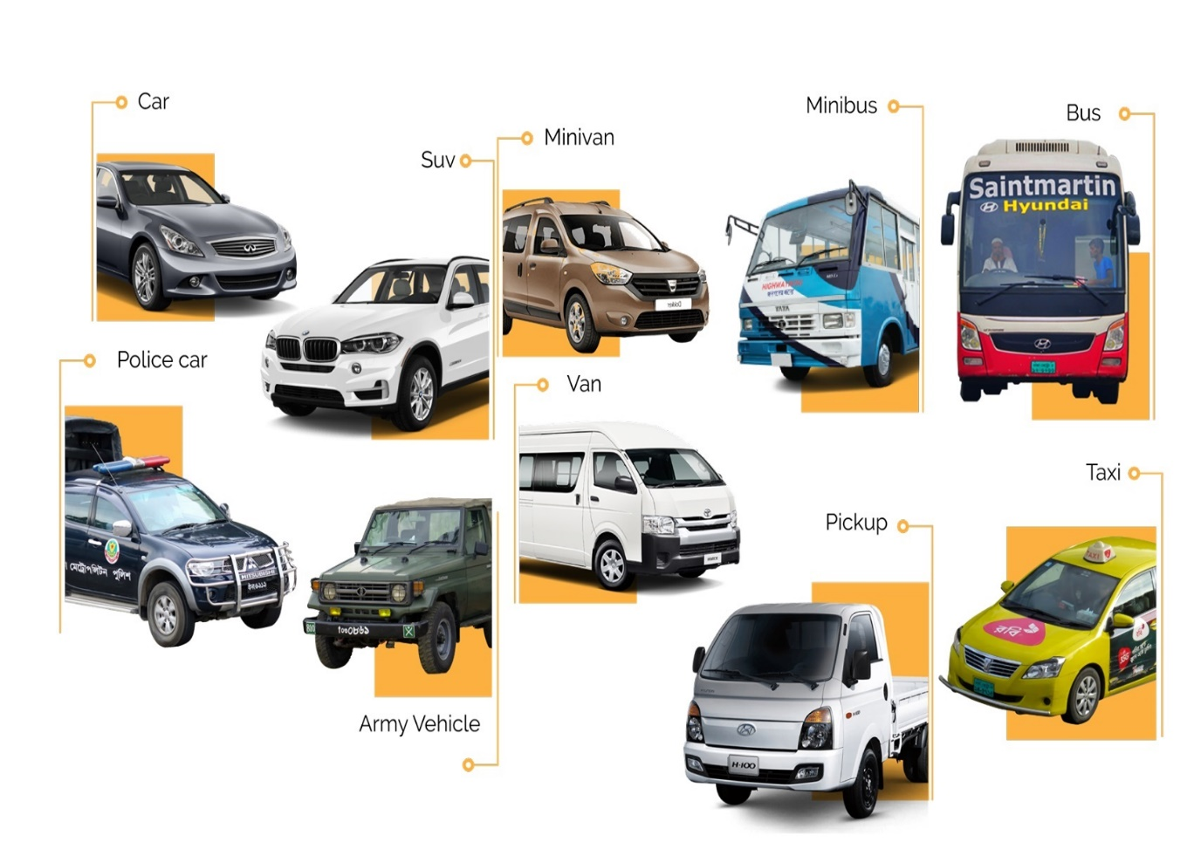
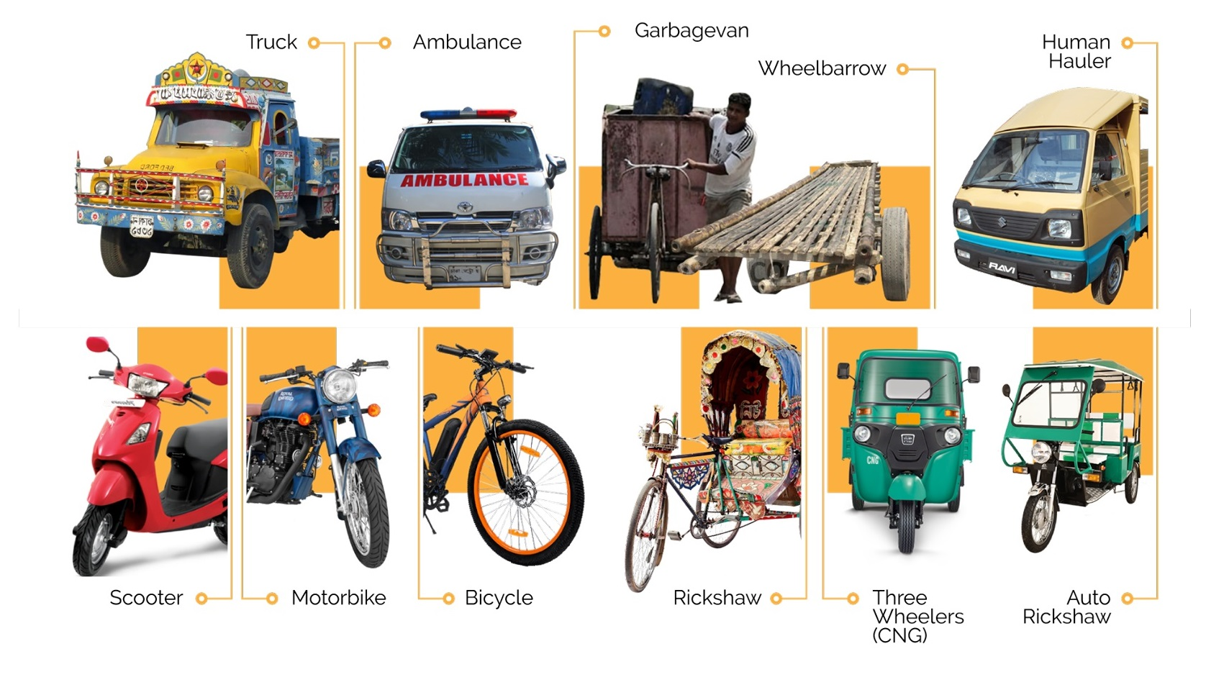
Classes of Vehicle
Total Classes: 21

Slide 8
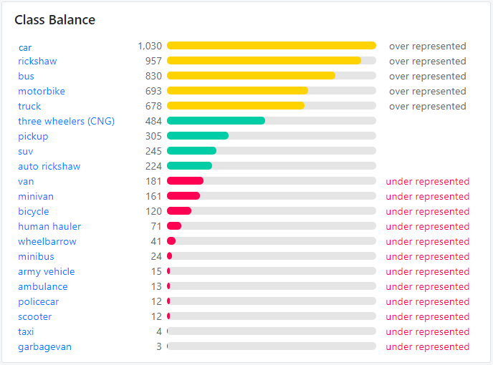
Dataset statistics
Datasets preprocessing in Roboflow.ai
Total Images: 4000
Resolution Used: 512 x 512 px
Total Classes: 21
Total Bounding Box: 7664
Class Imbalanced Observed
Figure: Sample statistics of 1000 images

Slide 9
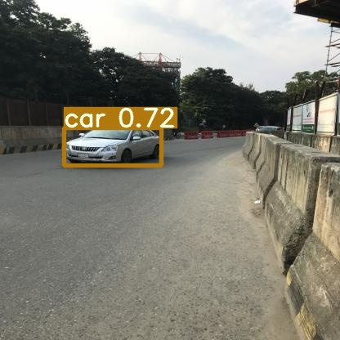
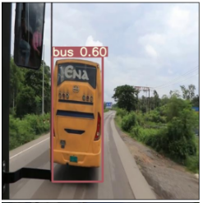
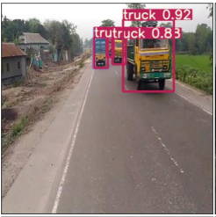
SOME OUTPUT PICTURES AFTER MODEL TRAIN

Slide 10
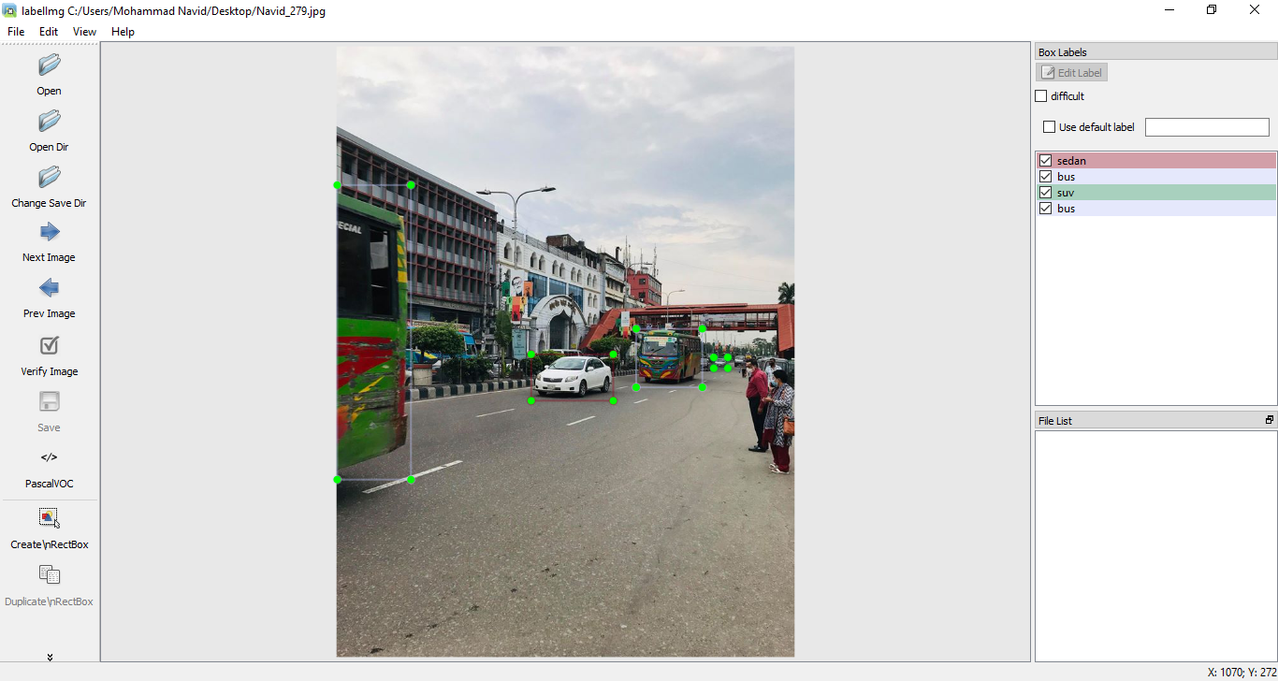
Image annotation using labelImg tool

Slide 11
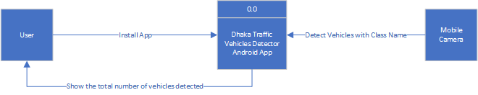
Context LEVEL Data-flow diagram

Slide 12
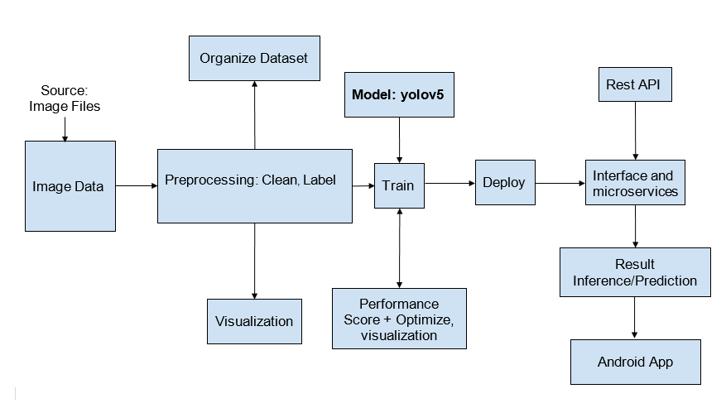
methodology
Machine Learning Pipeline

Slide 13
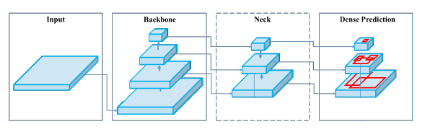
Methodology(Cont.)
Architecture of YOLOv5
Model backbone
Extract important features from the given input image.
Model Neck
Generates features pyramids that helps to identify the same object with different sizes and scales.
Model Head
Applies anchor boxes on features and generates final output vectors with class probabilities, object ness scores and bounding boxes.
Other Aspects of YOLOv5
Augmentation Used: Mosaic
Bounding Box Anchor: Learned from dataset automatically with K-means and genetic learning algorithm
Figure: Object Detection Process
Reference: Bochkovskiy, A., Wang, C.Y. and Liao, H.Y.M., 2020. Yolov4: Optimal speed and accuracy of object detection. arXiv preprint arXiv:2004.10934.

Slide 14
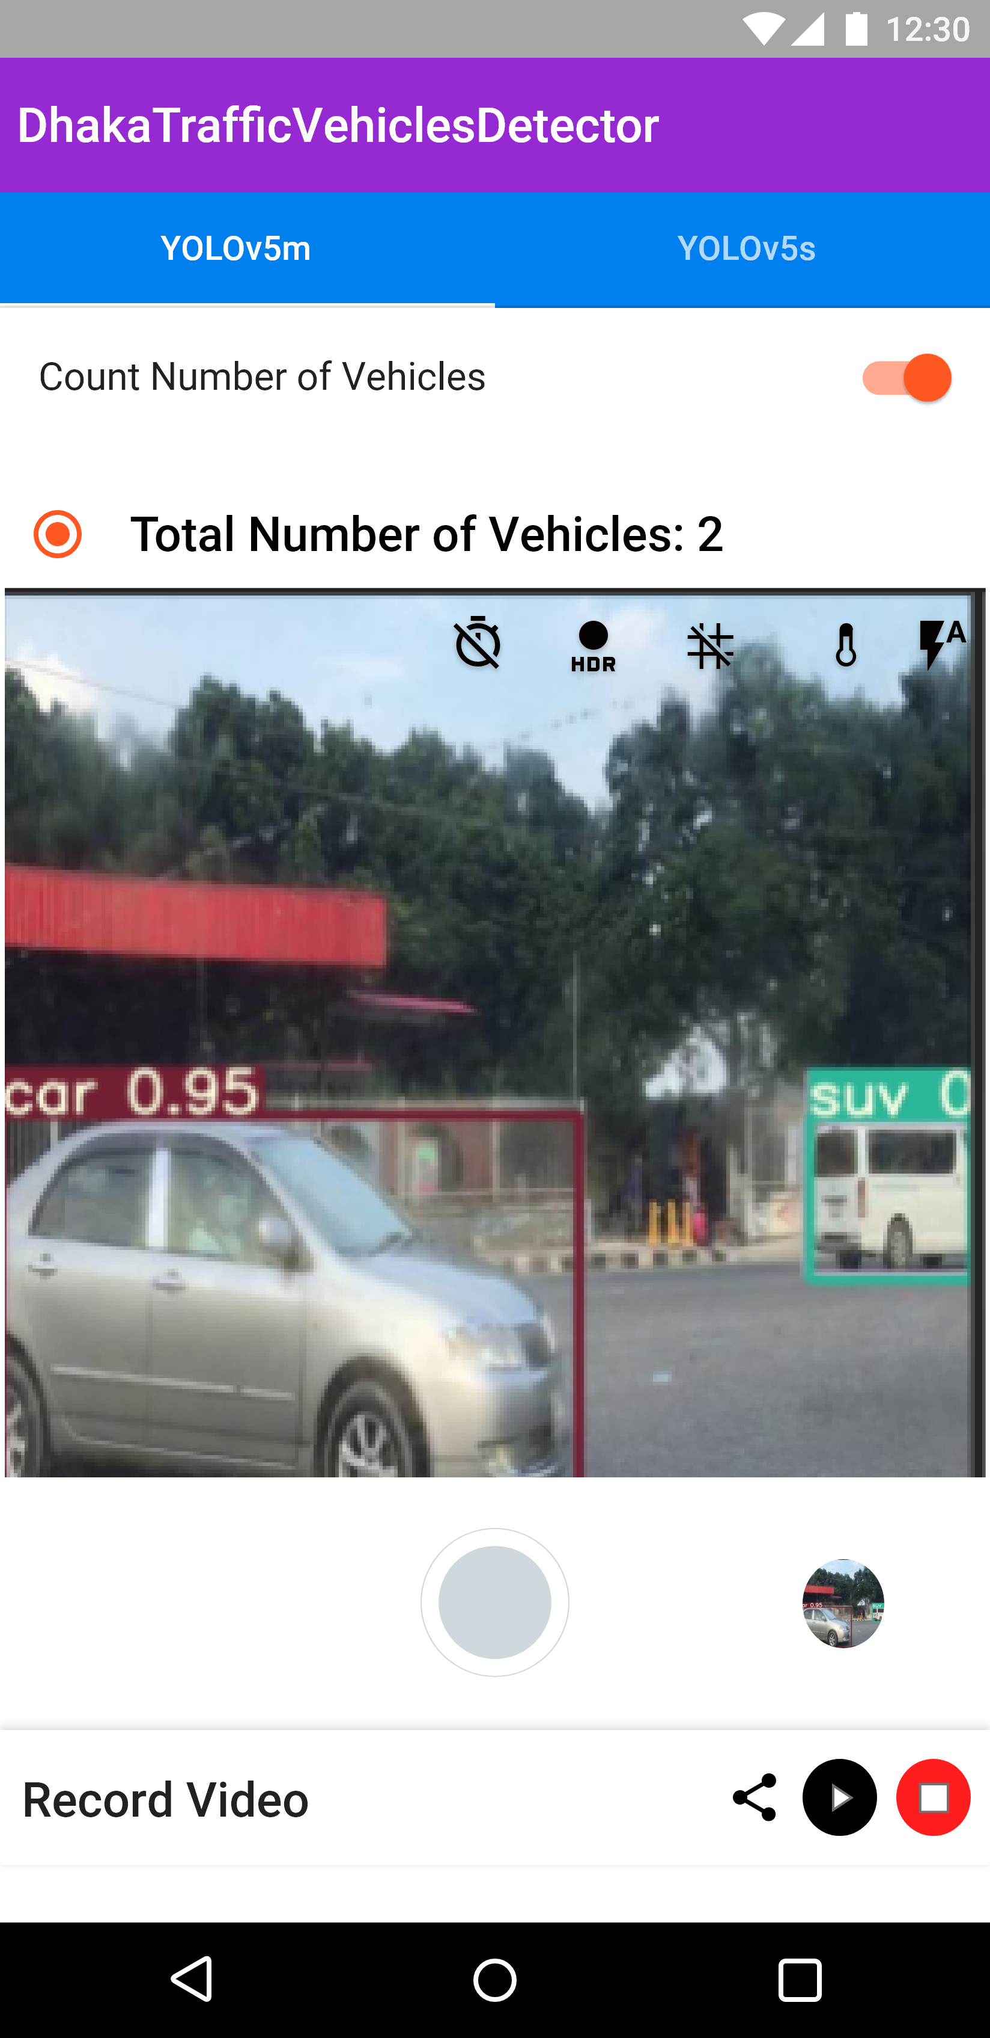
Final Outcome
An Android-Based Application which will detect different categories of vehicles and count the number of vehicles.
Beneficial for maintaining the traffic jam of Bangladesh.
Graph can be generated.
Measure the percentages of specific vehicles travelled through any route.
There will be less need of traffic police.
Figure: Prototype of our Android App

Slide 15
Gantt Chart

Slide 16
Thanks for watching

